Slide 1
Skills in Utility Management
October 2021

Slide 2
Facilities Management - Energy and Water Monitoring
What is Energy and Water Monitoring?
  Key Questions
Hardware Requirements to Enable Monitoring
  Energy Management
  Water Management
Monitoring Platform
  Copper
  Aqua
Field Support Skills
Case Studies

Slide 3
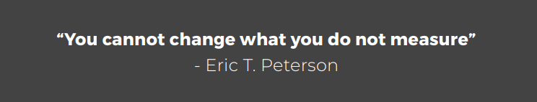
Energy and Water Monitoring
The Key Questions
  Are you managing your energy and water effectively?
  Are you being billed correctly and on the best tariff?
  Do you know where you are utilizing energy and water?
  Do you know what energy and water management opportunities exist?
  With systems like our Energy Monitoring and Water Monitoring Software, you are able to take control of your Energy and Water Costs and start saving immediately

Slide 4
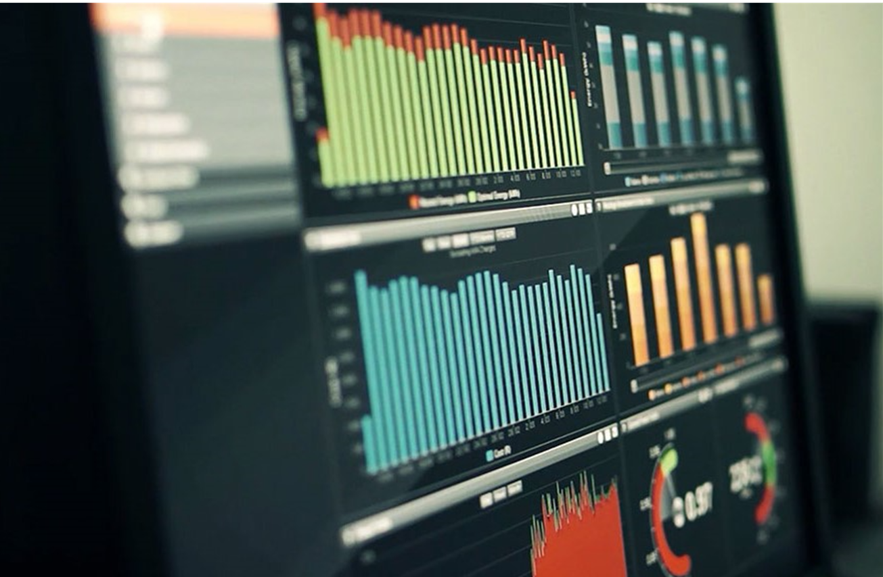
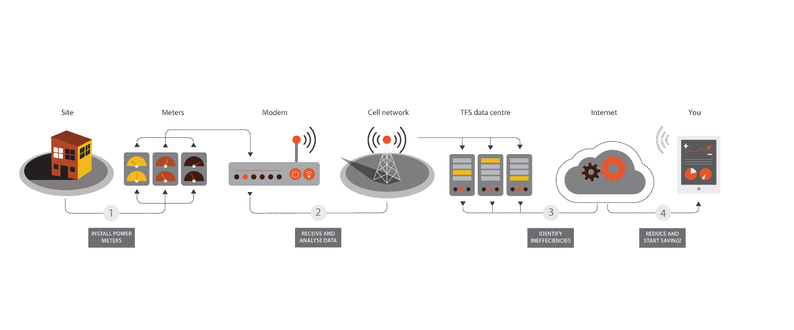
Energy Monitoring Hardware Requirements
Smart Meters (MV and LV)
Communications device (modem, ethernet network etc.) via Internet
Database
Web based front end
Dashboard for simple,
immediate understanding

Slide 5
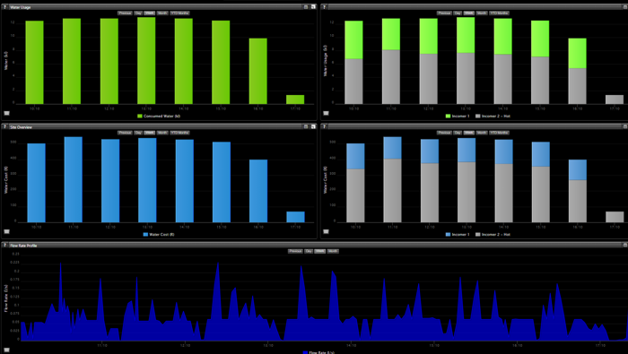
Water Monitoring Hardware Requirements
Smart Water Meters
Communications device (Sensus Wifi +3G, Sigfox, Lora, ) via Internet
Database
Web based front end
Dashboard for simple,
immediate understanding

Slide 6




Terra Firma Solutions Energy and Water Monitoring Platform
Anomalies
Trends
Peak Demand
Time of Use
Analyse and Evaluate Municipal Tariffs
Identify where you are Over or Under billed
Billing
  Bill tenants easily and accurately
  Fully automated reporting

Slide 7

Smart Metering Field Support Skills - Energy
Installation
Qualified Installation Electricians
Experienced in Smart Metering
Accuracy of Installation Essential:
  Single Line Diagrams
  Location of Smart Meter
  Programming of Smart Meter
  Communications Verification
  Data Validation
Maintenance
Qualified Electricians to support
  Loss of Communication – meter offline
  Loss of Power – meter offline
  Load Profile – incorrect
  Very rare that we experience meter failure

Slide 8

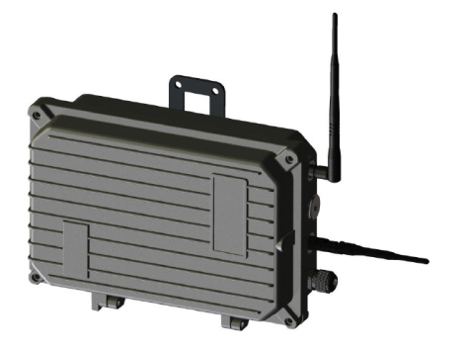
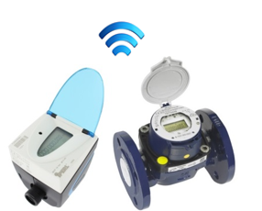
Smart Metering Field Support Skills - Water
Installation
Qualified Installation Plumbers / Technicians
Experienced in Smart Metering
Accuracy of Installation Essential:
  Location of Smart Meter
  Programming of Smart Meter
  Communications Verification
  Data Validation
Maintenance
Qualified Plumbers / Technicians to support
  Loss of Communication – meter offline
  Constant Zero – no flow
  Flow Profile – incorrect, reverse flow, multipliers

Slide 9
Smart Electricity Metering Case Studies
Case Studies
Residence
  Main Electrical Incomer not equal to the sum of all the sub electrical meters at the facility
    Sub meter examples:
      Kitchens, Heat Pumps and Bathrooms
    Additional supplies not accounted for
  Meters may be incorrectly programmed
  Breakers labelled incorrectly
  Single Line Diagrams outdated
Success Stories
Tracking of all Residences electrical consumption
Monitoring of night and vacation loads
Apply energy efficient interventions:
  LED Lighting
  Change in human behaviour
  Heat Pumps

Slide 10
Smart Water Metering Case Studies
Case Studies
University Residences
  Establish current consumptions at SU residences
  Identify poor behaviour, anomalies and trends
  Main water incomer(meter) not equal to the sum of all the sub water meters at the facility
    Sub water meter examples:
      Kitchens, Heat Pumps and Bathrooms
Success Stories
Tracking of burst pipes through alerts
  Response time reduce, limited wastage
Monitoring of night and vacation consumption
  Greater understanding of water use
Influence change in behaviour
  Sharing of information to all

Slide 11
Thank You

